Slide 1
WSN sim
A quick overview

Slide 2
Why?
Existing solutions lacking or bloated
Mostly focused on 802.11 or propriatary solutions
NS-2, NS-3, Contiki (cooja), TinyOS (TOSSIM), NetSim were investigated

Slide 3
What?
Simulating a large number of nRF51 devices with relatively realistic hardware restrictions
Radio turn around time
Packet collisions
Clock drift
Abstraction level approx. like Phoenix HAL-stack
Graphical representations for better understanding

Slide 4
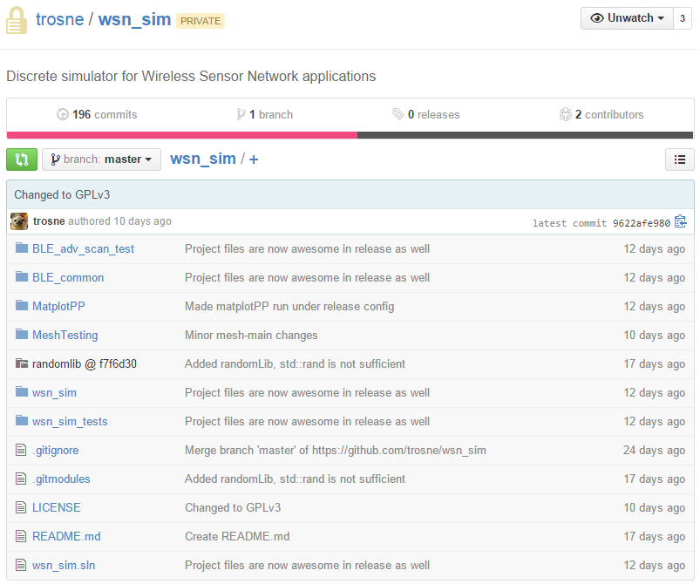
Components
wsn_sim: core simulator
BLE_common: BLE packets
BLE_adv_scan_test
MeshTesting: Initial mesh attempt
The rest is support modules

Slide 5
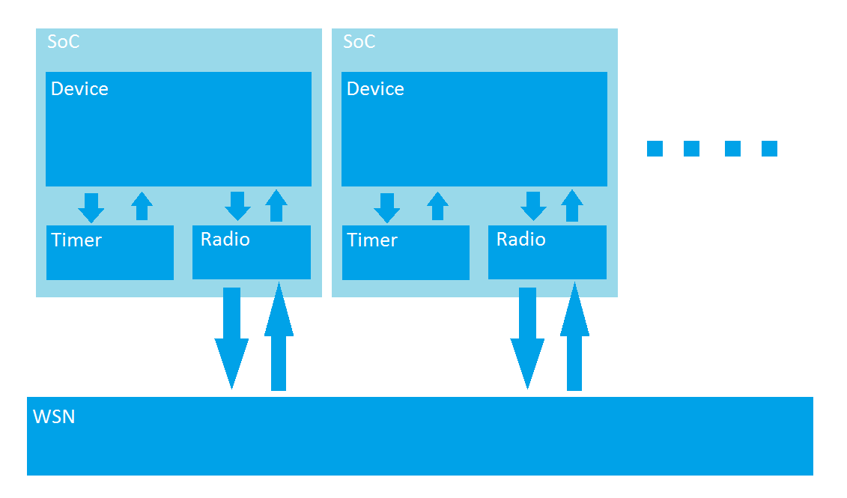
Core Network-part

Slide 6
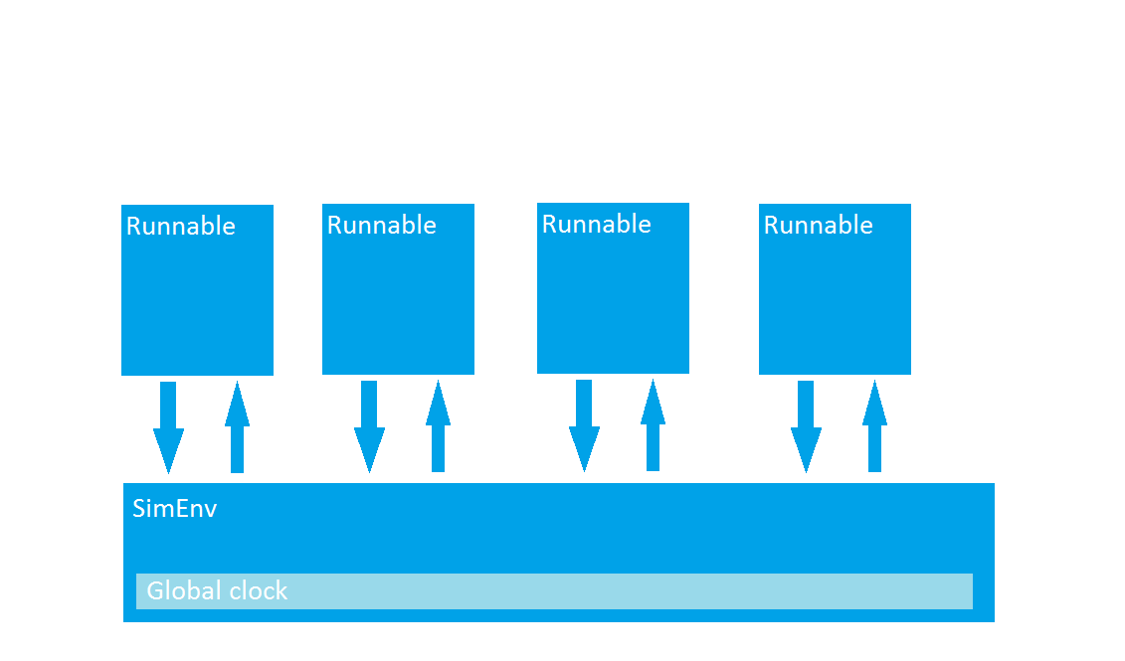
Core simulator-part

